Slide 1

AI Briefings and Its Development Trends
Bigger Data : Adversarial Attacks : Smarter Decisions : Exceptional Future
江明， 博士， 教授， 博导
Faculty of Engineering and IT, Univeristy of Technology, Sydney,
Cyber Security Research Institute, Deakin University, Melbourne, Australia
Former Member of Australian Centre for Cyber Security (ACCS), at UNSW Canberra
Teaching Unit: Emerging Frontiers in AI, Computational Intelligence, and Data Analytics

Slide 2



1.Self-Introduction
Over 15 years academic experiences, 9 years of teaching
Research areas - Data driven cyber security, Fault analysis/Fraud Detection, Social network spamming detection, Computational Intelligence and applications.
Mastery of theoretic knowledge on anti-cyber attacks with rich industrial project experiences
1
A/P in University of Technology, Sydney and Deakin University, Course Director (Bachelor);
UNSW VC Postdoctoral Fellowship, 2011（Supervisor：Prof. Michael R. Frater, Rector of UNSW@ADFA）
2
PhD, UTS（Supervisor：Hung T. Nguyen, Former Dean of FEIT, UTS）
3
Master of Computer Science, UNSW（Supervisor：Prof. Ian R. Petersen, ANU, Former ARC Chair）
4
Research funds up to 17 million RMB with over 16 projects, also include 3 NSFC projects and Industry-funded projects.
Published over 220 papers in high quality journal and international conferences, 125 journals, recently five years, 28 articles in Top SCI Tier 1 and 2 journal. Published 3 book chapters and one invented Australian patent. KBS AE, and a number of journal’s reviewers.
5

Slide 3


Teaching Syllabus:
Course Name: Emerging Frontiers in AI, Computational Intelligence, and Data Analytics

Slide 4
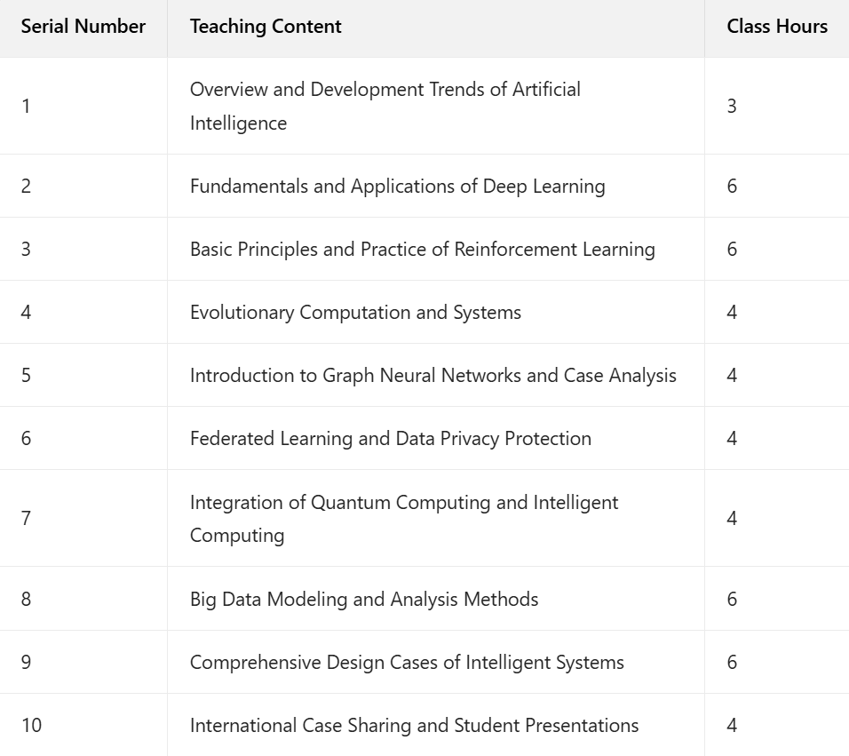
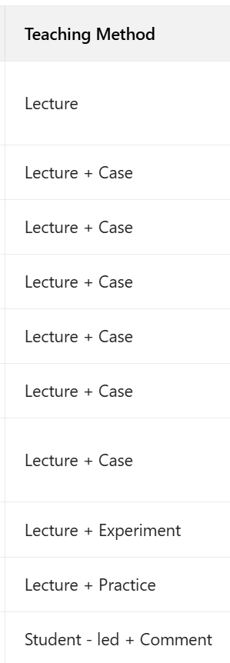

Slide 5

CONTENTS
01
Introduction to Artificial Intelligence
02
History of AI
03
Development of AI in China
04
Core Technologies of AI
05
Applications of AI
06
Ethical and Social Implications of AI

Slide 6
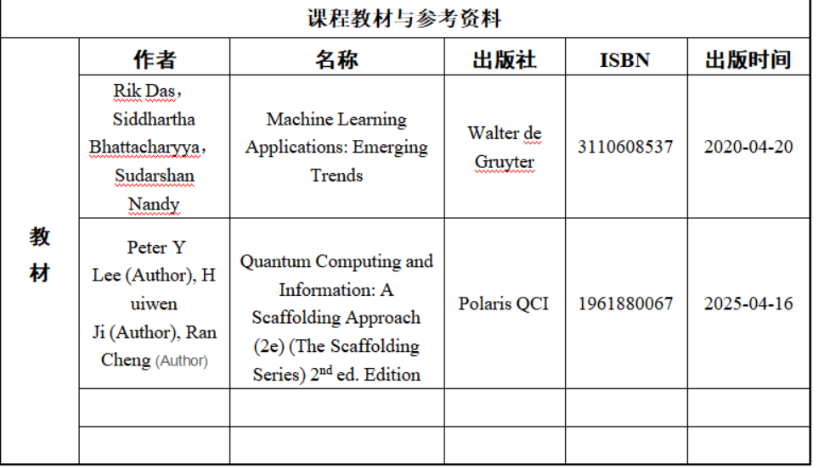
CONTENTS
07
Future Trends and Challenges
08
Conclusion

Slide 7
Introduction of Artificial Intelligence

Slide 8

Definition and Origins
Definition of AI
Artificial Intelligence (AI) refers to the simulation of human intelligence in machines that are programmed to think like humans and mimic their actions. It encompasses a range of capabilities from simple automation to complex decision-making.
Historical Background
The concept of AI dates back to ancient myths of artificial beings endowed with intelligence. However, the field of AI as we know it today began in the 1950s with the Dartmouth Conference, which aimed to explore the possibility of creating machines that could simulate human intelligence.
Key Milestones
Over the decades, AI has seen significant milestones. In the 1960s, the first AI programs were developed. The 1980s saw the rise of expert systems. More recently, breakthroughs in machine learning and deep learning have propelled AI to new heights, with applications in various fields.

Slide 9
History of AI
Early Beginnings
Major Milestones
Modern Developments
The concept of AI dates back to ancient myths and stories of artificial beings endowed with intelligence. However, the field of AI as we know it today began in the 1950s. The Dartmouth Conference in 1956 is often considered the birth of AI, where a group of scientists gathered to discuss the possibility of creating machines that could think like humans.
Over the years, there have been several major milestones in AI. In the 1960s, the first AI programs were developed, including the General Problem Solver and the Logic Theorist. In the 1970s, expert systems emerged, which were designed to solve complex problems in specific domains. The 1980s saw the rise of machine learning, with algorithms such as decision trees and neural networks being developed.
In recent years, AI has made significant progress, driven by advances in computing power and the availability of large amounts of data. Deep learning, a subfield of machine learning, has achieved remarkable success in areas such as image and speech recognition. AI is now being applied in various fields, including healthcare, finance, transportation, and entertainment.

Slide 10
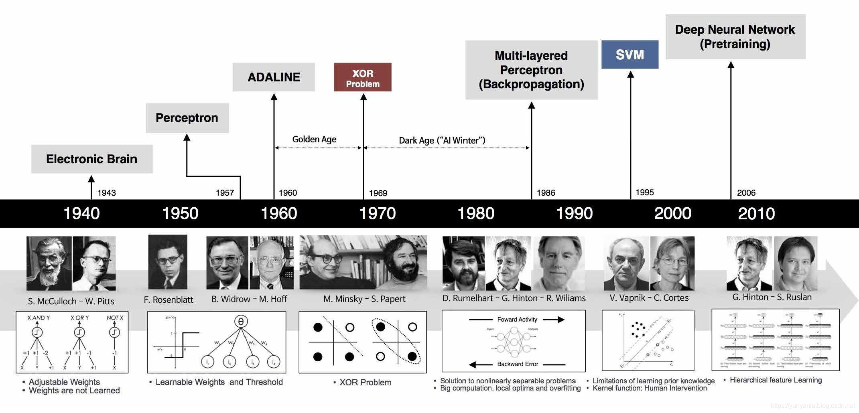
History of AI
Early Beginnings
Major Milestones
Modern Developments
The concept of AI dates back to ancient myths and stories of artificial beings endowed with intelligence. However, the field of AI as we know it today began in the 1950s. The Dartmouth Conference in 1956 is often considered the birth of AI, where a group of scientists gathered to discuss the possibility of creating machines that could think like humans.
Over the years, there have been several major milestones in AI. In the 1960s, the first AI programs were developed, including the General Problem Solver and the Logic Theorist. In the 1970s, expert systems emerged, which were designed to solve complex problems in specific domains. The 1980s saw the rise of machine learning, with algorithms such as decision trees and neural networks being developed.
In recent years, AI has made significant progress, driven by advances in computing power and the availability of large amounts of data. Deep learning, a subfield of machine learning, has achieved remarkable success in areas such as image and speech recognition. AI is now being applied in various fields, including healthcare, finance, transportation, and entertainment.

Slide 11
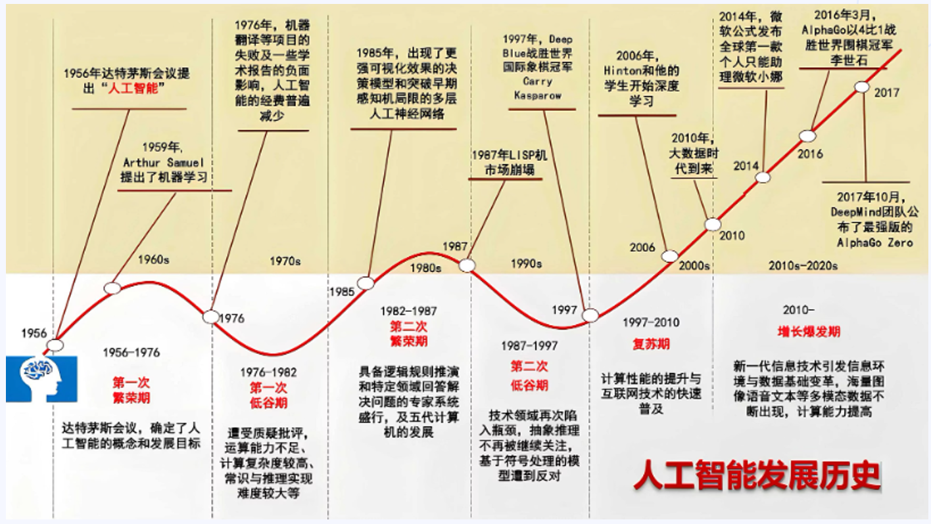
History of AI
Early Beginnings
Major Milestones
Modern Developments
The concept of AI dates back to ancient myths and stories of artificial beings endowed with intelligence. However, the field of AI as we know it today began in the 1950s. The Dartmouth Conference in 1956 is often considered the birth of AI, where a group of scientists gathered to discuss the possibility of creating machines that could think like humans.
Over the years, there have been several major milestones in AI. In the 1960s, the first AI programs were developed, including the General Problem Solver and the Logic Theorist. In the 1970s, expert systems emerged, which were designed to solve complex problems in specific domains. The 1980s saw the rise of machine learning, with algorithms such as decision trees and neural networks being developed.
In recent years, AI has made significant progress, driven by advances in computing power and the availability of large amounts of data. Deep learning, a subfield of machine learning, has achieved remarkable success in areas such as image and speech recognition. AI is now being applied in various fields, including healthcare, finance, transportation, and entertainment.

Slide 12
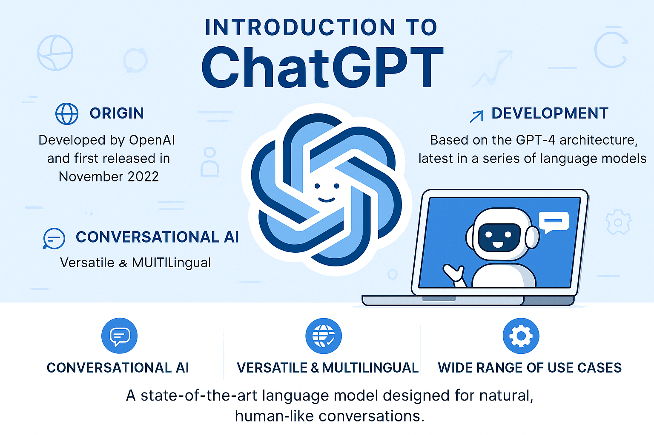
History of AI
Origin: Developed by OpenAI, based on the GPT series
Evolution: From GPT-1 (2018) to GPT-4 (2023)
Core Features: Text generation · Q&A · Coding · Multilingual support

Slide 13

Types of AI
Reactive Machines
Reactive machines are the simplest form of AI. They perceive the world directly and act on what they see. They don't have memory or the ability to use past experiences to inform future decisions. An example is Deep Blue, the chess-playing computer.
Theory of Mind
Theory of mind AI is a more advanced concept. It involves understanding that other entities have their own beliefs, desires, and intentions that impact their decisions. This type of AI is still in the research phase and aims to create machines that can interact with humans more naturally.
Limited Memory
Limited memory AI can use past experiences to inform current decisions. This type of AI includes some advanced machine learning models that can learn from data over time. Autonomous vehicles are a good example, as they use sensors and data to navigate.
Self-Aware
Self-aware AI is the most advanced and hypothetical form of AI. It would have a sense of self, consciousness, and emotions. This type of AI is still a topic of speculation and ethical debate, as it raises questions about the nature of intelligence and consciousness.

Slide 14
the development history of artificial intelligence in China

Slide 15
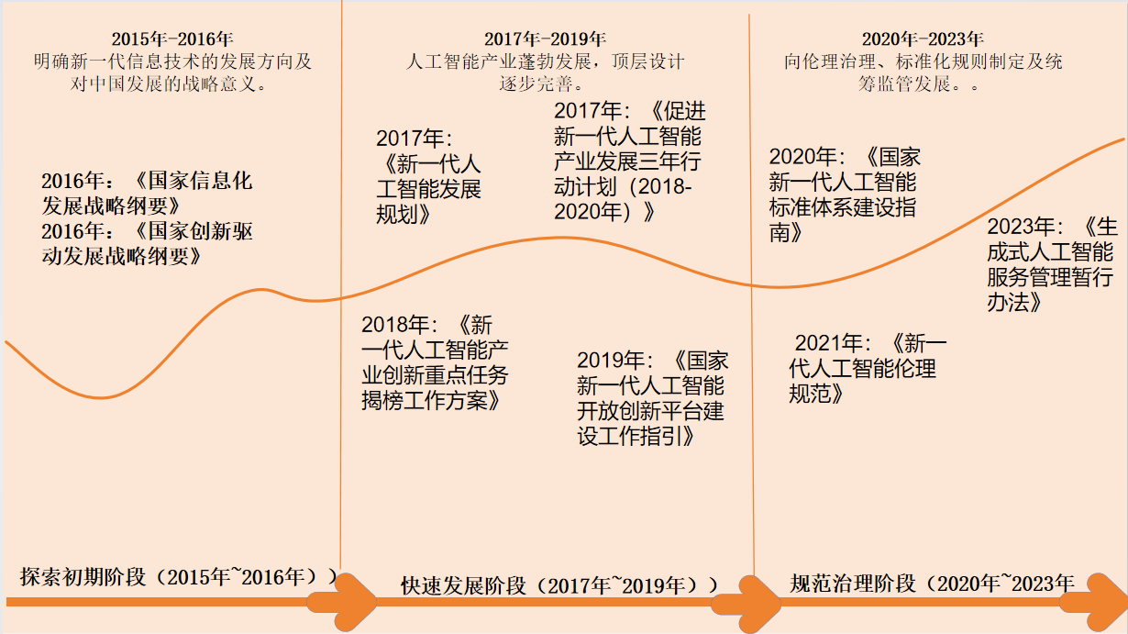
History of AI In China

Slide 16
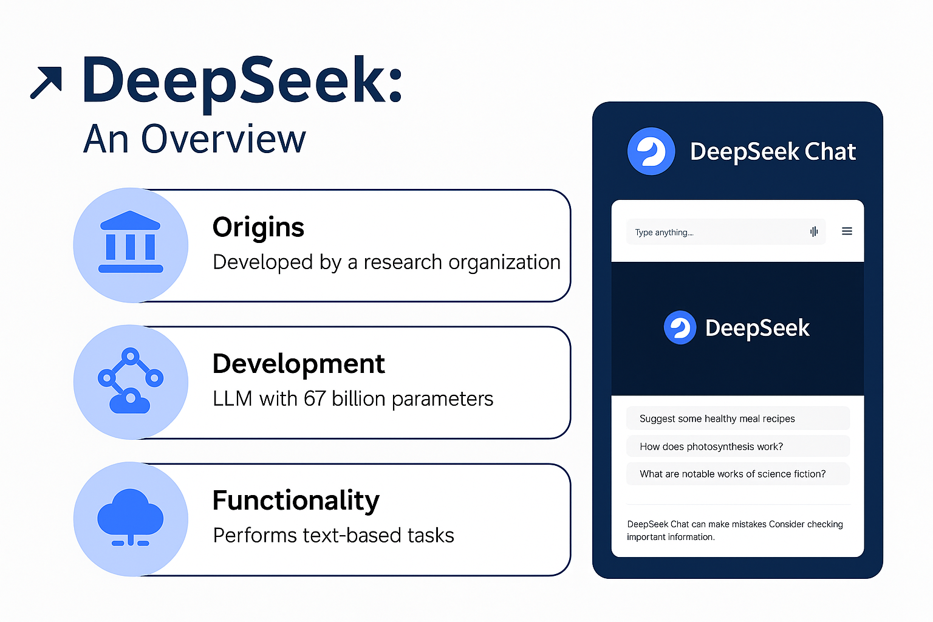
DeepSeek
Developed by: DeepSeek (China)
Model Type: Large Language Model (LLM)
Key Features:
Chinese-English bilingual capabilities
Strong performance in reasoning and math
Open-source and extensible architecture

Slide 17

Company Overview
01
Founding and Vision
DeepSeek was founded with the vision of leveraging cutting-edge AI technologies to drive innovation in multiple domains. It aims to create advanced generative AI models that can solve complex problems and contribute to the progress of various industries.
02
Core Team and Expertise
The core team of DeepSeek consists of top experts in AI research and development. They have extensive experience in deep learning, natural language processing, and computer vision. Their expertise enables DeepSeek to stay at the forefront of generative AI advancements.
Funding and Partnerships
03
DeepSeek has secured significant funding from leading investors. This financial support allows it to invest in research and development. It also collaborates with academic institutions and other companies to expand its capabilities and accelerate the application of generative AI.

Slide 18
Technology and Innovation
Advanced AI Models
Research Contributions
Innovation in Data Handling
DeepSeek has developed advanced generative AI models that outperform many existing solutions. These models are designed to generate high-quality and diverse content. They are optimized for different applications, such as text generation, image synthesis, and more.
The company actively contributes to the research community. It publishes papers on innovative techniques and shares its findings at conferences. This helps to advance the overall understanding and development of generative AI.
DeepSeek focuses on improving data handling for generative AI. It develops methods to efficiently collect, preprocess, and augment data. This ensures that the models are trained on high-quality and diverse datasets, leading to better performance.

Slide 19
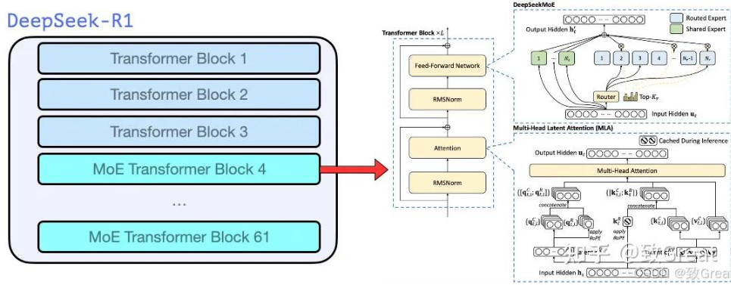
Technology and Innovation
Advanced AI Models
Research Contributions
Innovation in Data Handling
DeepSeek has developed advanced generative AI models that outperform many existing solutions. These models are designed to generate high-quality and diverse content. They are optimized for different applications, such as text generation, image synthesis, and more.
The company actively contributes to the research community. It publishes papers on innovative techniques and shares its findings at conferences. This helps to advance the overall understanding and development of generative AI.
DeepSeek focuses on improving data handling for generative AI. It develops methods to efficiently collect, preprocess, and augment data. This ensures that the models are trained on high-quality and diverse datasets, leading to better performance.
Notes:
这个如何讲解？

Slide 20
Products and Solutions
Text Generation Tools
DeepSeek offers powerful text generation tools. These tools can generate coherent and contextually relevant text for various purposes. They are used in content creation, customer service, and other applications where natural language is essential.
Image and Video Generation
The company also provides solutions for image and video generation. These tools can create realistic and visually appealing content. They are used in advertising, entertainment, and other industries to enhance visual experiences.
Customized Solutions
DeepSeek works closely with clients to develop customized generative AI solutions. It understands the specific needs of different industries and tailors its models and applications accordingly. This ensures that clients can achieve their goals effectively.

Slide 21
"Foundation-Building Project" for Technological Self-Reliance
Intelligent Computing
Quantum Computing
Privacy Computing
Optimize 100-billion-parameter large model training to achieve 40% reduction in carbon emissions per unit 算力 (Institute of Computing Technology, CAS + enterprises).
Build quantum-classical hybrid platform and 3 E-level supercomputing quantum collaboration centers (National Laboratories).
Breakthrough in fully homomorphic encryption performance to reach 100Kops/sec (50x improvement) (Cryptography Administration + enterprises).

Slide 22



"Data Element ×" Scenario Empowerment Plan
Manufacturing
Healthcare
Agriculture
Industrial Data Space Construction: 25% reduction in product defect rate; 18% increase in OEE (20 national-level industrial data spaces).
Cultivated Land Data Mapping: Cover 95% of high-standard farmland (30% reduction in agricultural insurance compensation rate).
National Health Big Data Center: Connect 80% of tertiary hospitals (50% improvement in rare disease screening efficiency).

Slide 23

"Great Wall System" for Data Security
Technical Defense
Develop blockchain audit platform for data circulation (100% coverage of cross-border data flow).
Institutional Innovation
Sovereignty Protection
Establish data security insurance fund (20 billion yuan funded by Ministry of Finance, covering 100,000 enterprises).
Release National Core Data Catalog (prohibiting export of classified/sensitive data).

Slide 24
Core Technologies of AI

Slide 25
Machine Learning
Supervised Learning
Supervised learning involves training a model on labeled data. The model learns to predict outcomes based on input features. It is widely used in applications like image recognition and spam detection, where the model is trained on examples with known outputs.
Unsupervised Learning
Reinforcement Learning
Unsupervised learning is used when the data is unlabeled. The model identifies patterns and structures in the data without any prior guidance. It is useful for tasks like clustering and anomaly detection, helping to discover hidden relationships in large datasets.
Reinforcement learning involves an agent learning to make decisions by taking actions in an environment to maximize some notion of cumulative reward. It is used in robotics and gaming, where the agent learns through trial and error to achieve a goal.

Slide 26

Deep Learning
01
02
03
Neural Networks
Convolutional Neural Networks (CNNs)
Recurrent Neural Networks (RNNs)
Neural networks are the foundation of deep learning. They are inspired by the structure of the human brain and consist of layers of interconnected nodes. They are capable of learning complex patterns in data and are used in a wide range of applications, from speech recognition to natural language processing.
CNNs are a type of neural network specialized for processing grid-like data, such as images. They use convolutional layers to extract features from images, making them highly effective for tasks like image classification and object detection.
RNNs are designed to handle sequential data, such as time series or text. They maintain a hidden state that captures information about the sequence seen so far, making them useful for tasks like language translation and speech recognition.

Slide 27
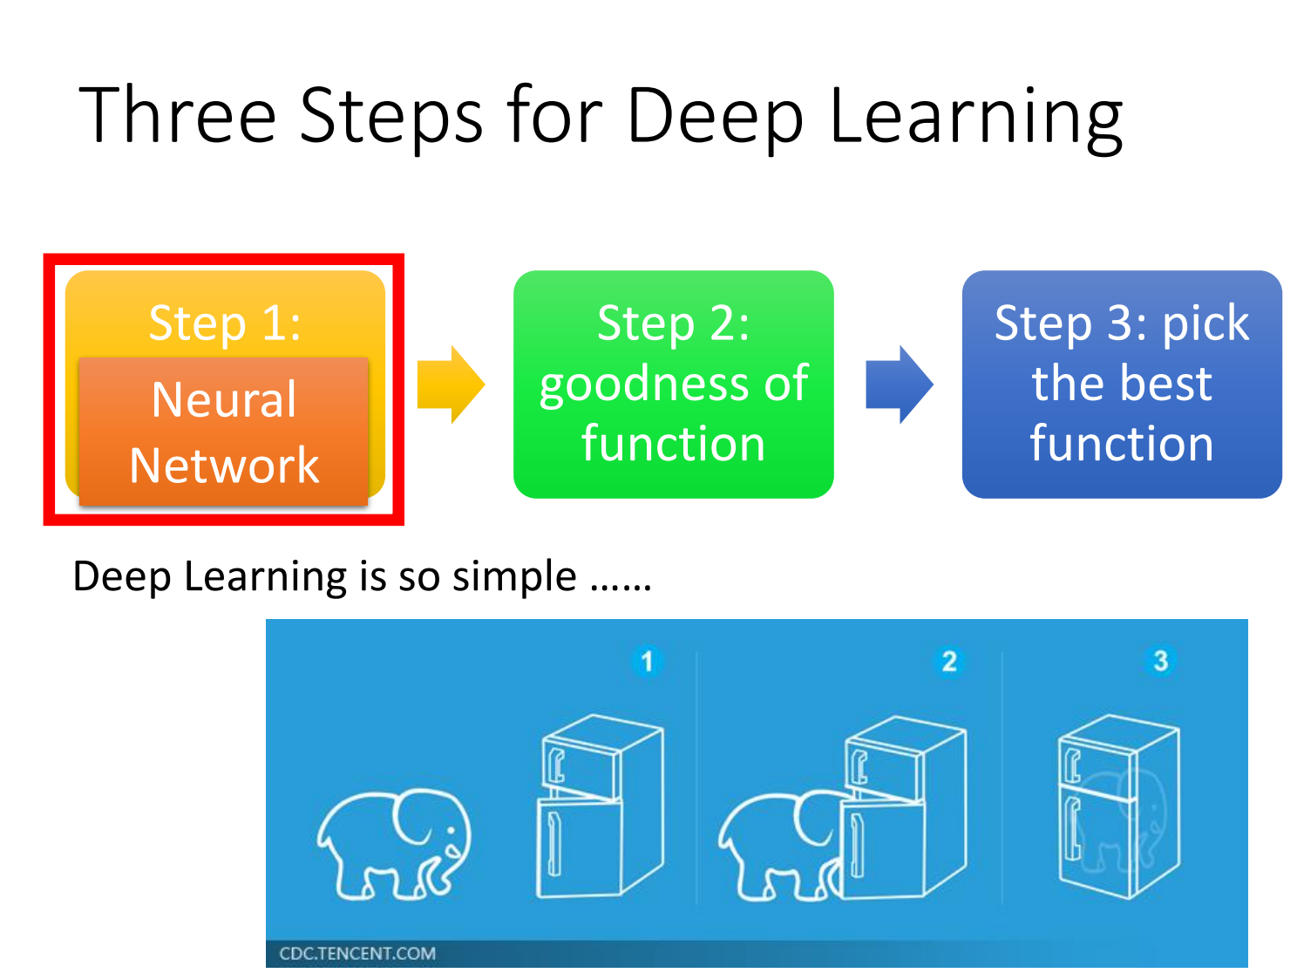
Deep Learning

Slide 28
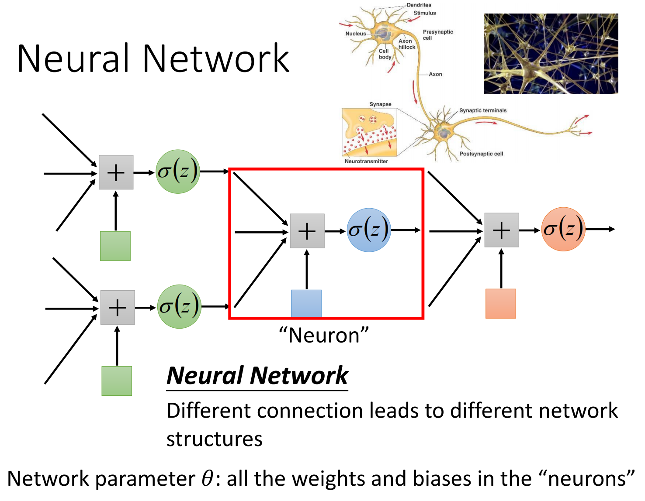
Deep Learning

Slide 29
Reinforcement learning
Reinforcement learning is learning what to do—how to map situations to actions——so as to maximize a numerical reward signal
Reinforcement learning is primarily composed of the agent, environment, state, action, and reward. When the agent executes an action, the environment transitions to a new state, and the environment provides a reward signal (positive or negative) for this new state. Subsequently, based on the new state and the reward feedback from the environment, the agent performs a new action according to a certain strategy. The above process is how the agent interacts with the environment through states, actions, and rewards.
Through reinforcement learning, the agent can learn which actions to take in which states to maximize its own rewards

Slide 30
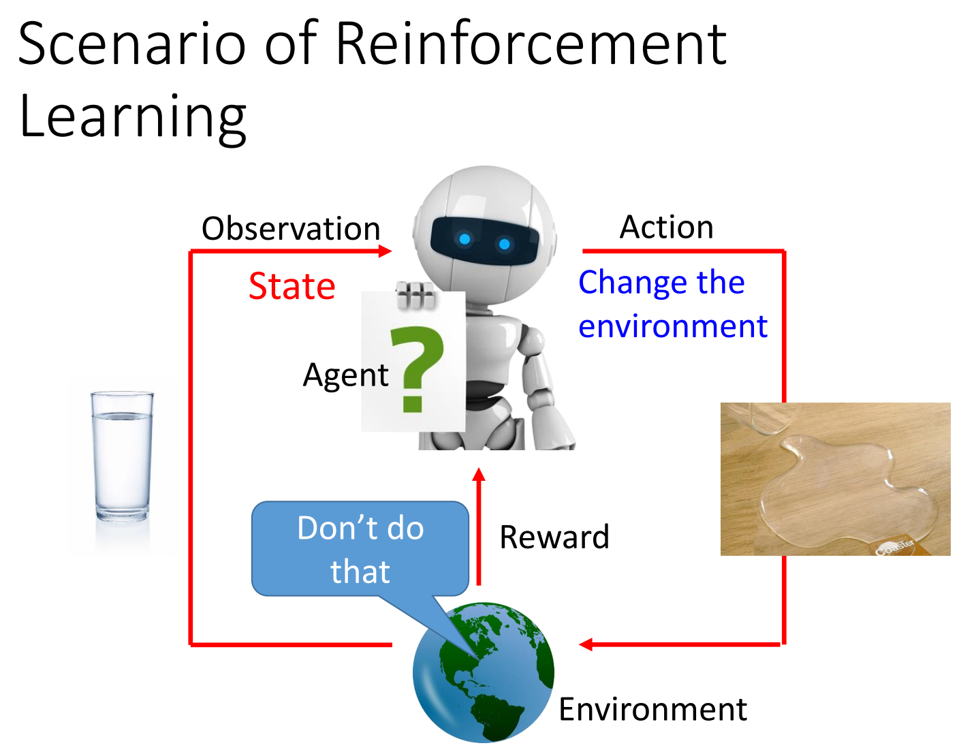
Reinforcement learning

Slide 31
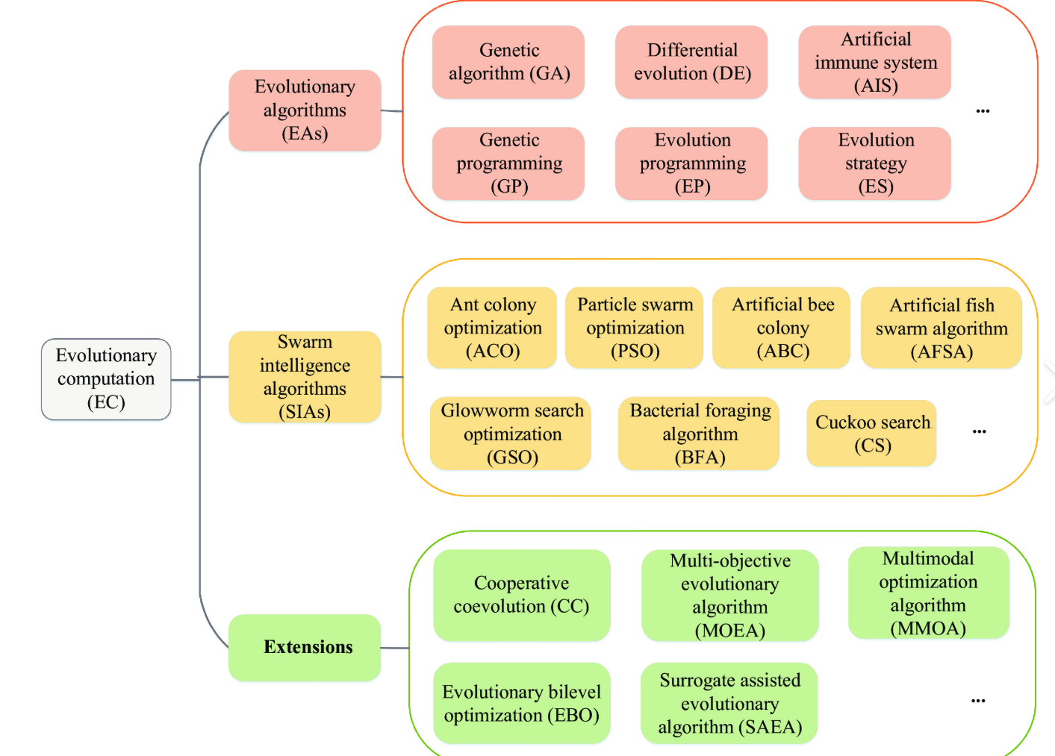
Evolutionary Computation and Systems
Evolutionary Computation (EC) is a family of population-based optimization algorithms inspired by biological evolution, including natural selection, mutation, recombination, and inheritance. These algorithms are designed to solve complex problems by iteratively improving a population of candidate solutions, mimicking the adaptive processes observed in nature.

Slide 32
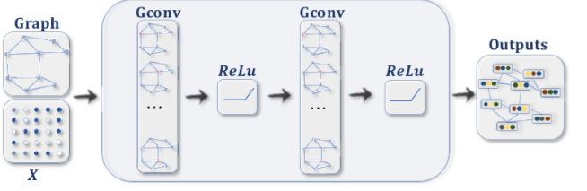
Graph Neural Networks (GNNs)
Graph Neural Networks (GNNs) are a class of deep learning models specifically designed to process and learn from graph-structured data. Unlike traditional neural networks that handle grid-like data (e.g., images) or sequential data (e.g., text), GNNs excel at capturing relationships and dependencies between interconnected entities, making them invaluable for tasks involving non-Euclidean data.

Slide 33
Federated Learning
Federated Learning (FL) is a distributed machine learning paradigm designed to train models across multiple decentralized devices or servers while keeping data localized. Unlike traditional centralized approaches—where data is aggregated into a single server—FL enables model training on edge devices (e.g., smartphones, IoT sensors) or local data centers, with only model updates (e.g., gradients, weights) shared between participants. This preserves data privacy, making it ideal for sensitive domains like healthcare, finance, and personal devices.

Slide 34
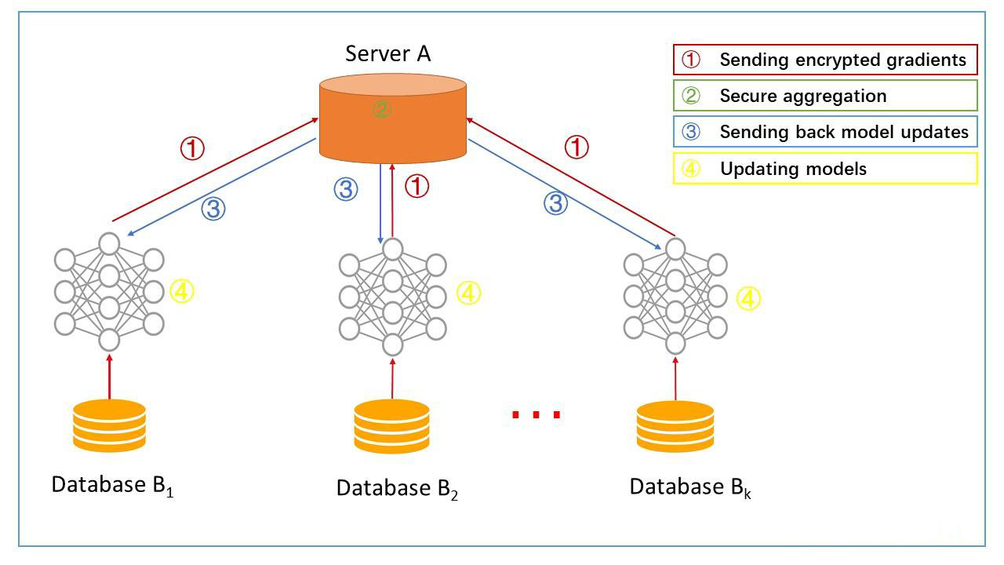
Federated Learning
Federated Learning (FL) is a distributed machine learning paradigm designed to train models across multiple decentralized devices or servers while keeping data localized. Unlike traditional centralized approaches—where data is aggregated into a single server—FL enables model training on edge devices (e.g., smartphones, IoT sensors) or local data centers, with only model updates (e.g., gradients, weights) shared between participants. This preserves data privacy, making it ideal for sensitive domains like healthcare, finance, and personal devices.

Slide 35
The Convergence of Quantum Computing and Artificial Intelligence
Quantum computing, a new computing model based on quantum mechanics, demonstrates enormous potential to outperform classical computers. Leveraging properties like quantum superposition and entanglement, it can achieve exponential speedups in specific problems. This powerful parallel computing capability enables quantum computers to tackle complex issues that classical computers struggle with or cannot solve, injecting new vitality into AI development. The integration of quantum computing and AI is regarded as a key driver of the next-generation computing power revolution, promising disruptive breakthroughs across multiple fields

Slide 36
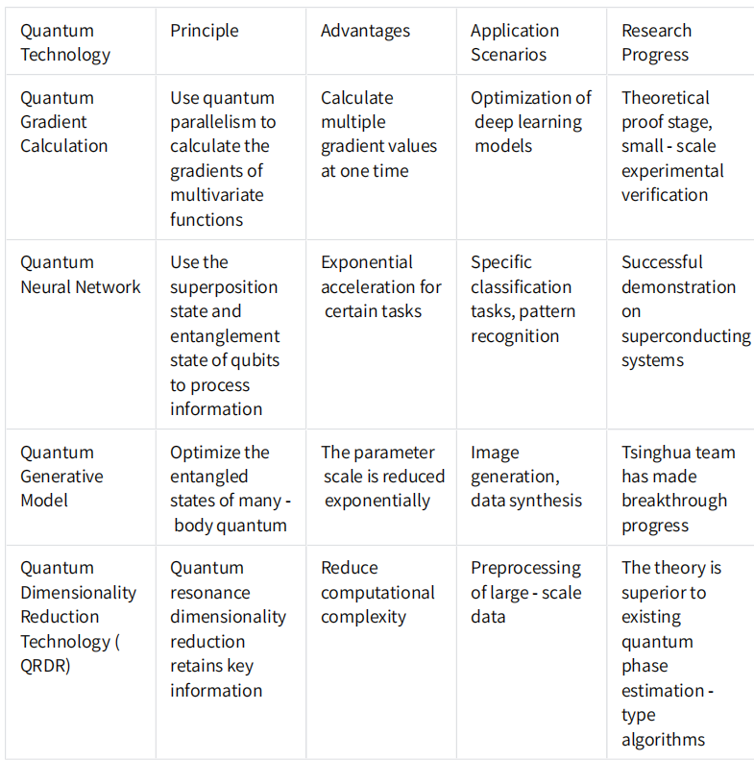
The Convergence of Quantum Computing and Artificial Intelligence

Slide 37
Big Data Modeling and Analytical Methods
Big data modeling and analysis refer to the processes of structuring large, complex datasets (characterized by volume, velocity, variety, veracity, and value) and extracting actionable insights using statistical, computational, and machine learning techniques.

Slide 38
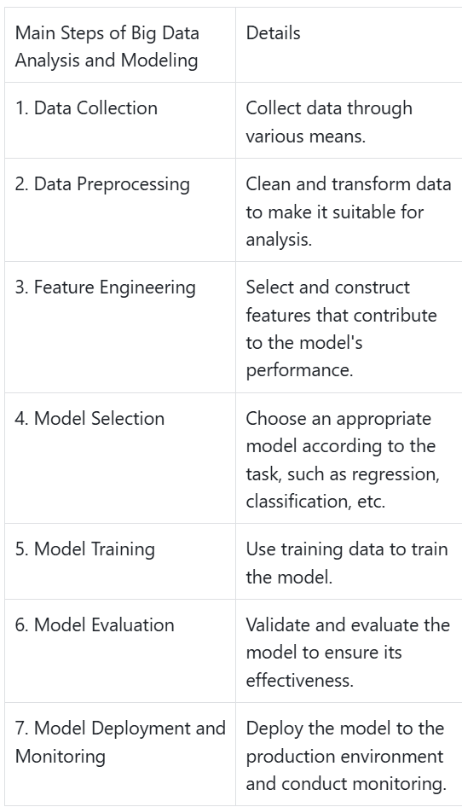
Big Data Modeling and Analytical Methods

Slide 39
Integrated Design of Intelligent Systems
The integrated design of intelligent systems refers to the holistic process of conceptualizing, developing, and optimizing interconnected systems that leverage artificial intelligence (AI), machine learning (ML), sensors, and computational algorithms to perceive, reason, and act autonomously or semi-autonomously. This approach emphasizes synergy between hardware, software, and data components to achieve complex, adaptive functionalities across diverse domains such as robotics, IoT (Internet of Things), healthcare, and smart manufacturing.

Slide 40
Natural Language Processing (NLP)
Text Processing
Language Generation
Language Understanding
Text processing involves converting raw text data into a format that can be understood by machines. This includes tasks like tokenization, stemming, and lemmatization. It is a crucial step in preparing text data for NLP applications.
Language understanding involves extracting meaning from text. This includes tasks like named entity recognition, sentiment analysis, and question answering. It enables machines to understand and interpret human language more effectively.
Language generation involves creating human-like text. This includes tasks like text summarization, chatbots, and content generation. It uses models like GPT to generate coherent and contextually relevant text.

Slide 41
Generative AI
What is Generative AI
Evolution and Milestones
Key Technologies
Generative AI refers to a type of artificial intelligence that can generate new content based on patterns it has learned from existing data. It has the ability to create text, images, music, and more, opening up a wide range of possibilities for various industries and applications.
Deep learning models such as GANs (Generative Adversarial Networks) and transformers are the backbone of generative AI. GANs consist of a generator and a discriminator that compete to improve the quality of generated content. Transformers leverage self-attention mechanisms to capture complex patterns in data.
The field of generative AI has seen rapid development. Early models like PixelRNN and PixelCNN laid the foundation. In recent years, models such as GPT (Generative Pre-trained Transformer) series have achieved remarkable results in natural language processing tasks, significantly advancing the capabilities of generative AI.

Slide 42
Applications of AI

Slide 43
Medical Diagnosis
01
Image Analysis
AI - powered algorithms can analyze medical images such as X - rays, CT scans, and MRIs with high accuracy. They can detect abnormalities like tumors, fractures, and diseases at an early stage, assisting doctors in making more precise diagnoses and improving patient outcomes.
02
Symptom Analysis
AI - based systems can analyze patient symptoms and medical history to suggest possible diagnoses. By considering a wide range of factors and comparing them with vast medical databases, these systems help healthcare professionals narrow down potential causes and recommend appropriate tests or treatments.
Drug Discovery
03
AI accelerates the drug discovery process by analyzing large datasets of chemical compounds and biological interactions. It can predict the efficacy and safety of potential drugs, reducing the time and cost of bringing new medications to market. Machine learning models can also identify new drug targets and optimize drug formulations.

Slide 44
Patient Care
Remote Monitoring
AI - enabled devices and sensors allow for remote monitoring of patients' vital signs, such as heart rate, blood pressure, and glucose levels. This enables early detection of health issues and timely interventions, especially for patients with chronic conditions, reducing hospital readmissions and improving overall patient care.
Personalized Treatment Plans
Virtual Health Assistants
AI can analyze individual patient data, including genetic information, medical history, and lifestyle factors, to create personalized treatment plans. These plans are tailored to the specific needs of each patient, increasing the effectiveness of treatments and minimizing side effects.
Virtual health assistants powered by AI can provide patients with instant medical advice, answer health - related questions, and guide them through self - care. They can also remind patients to take medications, schedule appointments, and provide emotional support, enhancing the overall patient experience.

Slide 45
Customer Service
01
02
03
Chatbots and Virtual Assistants
Personalized Recommendations
Sentiment Analysis
AI - driven chatbots and virtual assistants can handle customer inquiries 24/7, providing instant responses and resolving issues efficiently. They can understand natural language, engage in meaningful conversations, and escalate complex queries to human agents when necessary. This improves customer satisfaction and reduces the workload on customer service teams.
AI algorithms analyze customer data to provide personalized product recommendations. By understanding individual preferences, purchase history, and browsing behavior, businesses can offer tailored suggestions that increase customer engagement, drive sales, and enhance the overall shopping experience.
AI - based sentiment analysis tools can analyze customer feedback from various sources, such as social media, reviews, and surveys. They can identify trends, detect issues, and gauge customer satisfaction levels. This helps businesses make data - driven decisions to improve products and services.

Slide 46
Marketing
Targeted Advertising
Predictive Analytics
Customer Segmentation
AI enables businesses to create highly targeted advertising campaigns by analyzing customer demographics, interests, and online behavior. It can predict which ads are most likely to resonate with specific audiences, resulting in higher click - through rates and conversion rates. This allows for more effective use of marketing budgets.
AI can segment customers into distinct groups based on their characteristics and behaviors. This allows businesses to tailor marketing messages and strategies to each segment, improving the relevance and effectiveness of their marketing efforts. It also helps in identifying high - value customer segments for targeted promotions.
AI - powered predictive analytics models can forecast customer behavior, such as purchase likelihood, churn probability, and lifetime value. This information helps businesses make informed decisions about customer acquisition, retention, and loyalty programs. It also enables proactive marketing strategies to address potential issues before they arise.

Slide 47
Supply Chain Management
Demand Forecasting
Inventory Optimization
Logistics and Routing
AI algorithms can analyze historical sales data, market trends, and external factors to accurately forecast demand. This helps businesses optimize inventory levels, reduce stockouts, and minimize excess inventory. Accurate demand forecasting also enables better production planning and resource allocation.
AI can optimize inventory management by analyzing real - time data on stock levels, sales velocity, and lead times. It can automate reorder processes, identify slow - moving items, and suggest optimal stocking levels. This reduces costs associated with inventory holding and improves overall supply chain efficiency.
AI - enabled logistics systems can optimize delivery routes, taking into account factors such as traffic conditions, weather, and delivery schedules. This reduces transportation costs, improves delivery times, and enhances customer satisfaction. AI can also optimize warehouse operations, such as storage layout and picking routes.

Slide 48
Investment Management
Portfolio Optimization
AI algorithms can analyze vast amounts of financial data to optimize investment portfolios. They can consider factors such as risk tolerance, investment goals, and market trends to create personalized portfolios. Machine learning models can continuously monitor and adjust portfolios to maximize returns and minimize risks.
Algorithmic Trading
AI - driven algorithmic trading systems can execute trades at high speed and with high precision. They can analyze market data, identify patterns, and make trading decisions based on predefined rules. This allows for more efficient trading and can improve investment performance.
Market Prediction
AI - based predictive models can analyze historical market data, news sentiment, and other factors to forecast market trends. While market prediction is inherently uncertain, AI can provide valuable insights to help investors make more informed decisions. It can identify potential opportunities and risks in the market.

Slide 49
Supply Chain Integration
Supplier Collaboration
AI can facilitate collaboration between manufacturers and suppliers by analyzing data on supply chain performance. It can identify potential issues, such as delays or quality problems, and enable proactive communication and resolution. AI - enabled platforms can also optimize supplier selection and evaluation.
Inventory Management
Logistics Coordination
AI - driven inventory management systems can optimize stock levels by analyzing demand forecasts, lead times, and production schedules. They can automate reorder processes and ensure that the right amount of inventory is available at the right time. This reduces costs associated with excess inventory and stockouts.
AI can coordinate logistics operations by optimizing transportation routes, scheduling deliveries, and managing warehouse operations. It can analyze real - time data on traffic conditions, weather, and inventory levels to make informed decisions. This improves efficiency, reduces costs, and ensures timely delivery of products.

Slide 50
Product Design and Development
01
02
03
Generative Design
Simulation and Testing
Customer - Driven Design
AI - powered generative design tools can create innovative product designs by exploring a vast number of design possibilities. They can consider factors such as performance, cost, and manufacturing constraints to generate optimized designs. This accelerates the product development process and leads to more efficient and sustainable products.
AI can enhance simulation and testing of products by analyzing large amounts of data from virtual and physical tests. It can predict product performance under different conditions and identify potential issues early in the design process. This reduces the need for expensive and time - consuming physical testing.
AI can analyze customer feedback and market trends to inform product design and development. It can identify customer needs and preferences, and suggest design improvements that align with market demands. This helps manufacturers create products that better meet customer expectations and drive market success.

Slide 51
Ethical and Social Implications of AI

Slide 52
Definition and Scope of AI Ethics
01
Core Concepts of AI Ethics
AI ethics examines the moral principles guiding AI development and use. It ensures AI aligns with human values, promoting fairness, transparency, and accountability in AI systems.
02
Historical Evolution of AI Ethics
AI ethics has evolved from early safety concerns to broader issues like bias and privacy. Milestones include the Asilomar AI Principles, which set guidelines for beneficial AI.
Current Debates in AI Ethics
03
Current debates focus on facial recognition, autonomous weapons, and employment impact. These discussions shape policies and public perception of AI.

Slide 53
Fairness and Bias in AI
Identifying Bias in Algorithms
Bias in AI algorithms can arise from skewed training data or flawed design. Identifying these biases is crucial to prevent discrimination in AI systems.
Strategies for Achieving Fairness
Techniques such as data preprocessing, algorithmic adjustments, and fairness metrics help mitigate bias. Fairness is essential for equal opportunities in hiring and lending.
Case Studies of Bias Mitigation
Examples like Google's efforts to reduce gender bias in translation algorithms demonstrate practical approaches to achieving fairness in AI.

Slide 54
Transparency and Explainability
Challenges in AI Transparency
Real-world Applications of Explainable AI
Methods for Enhancing Explainability
Complex AI models, especially deep learning systems, often act as black boxes. Understanding their decision-making processes is a significant challenge.
Techniques such as feature importance analysis and model-agnostic methods help explain AI decisions. Transparency is vital for building trust in AI applications.
In healthcare, explainable AI can help doctors understand diagnostic recommendations, improving patient outcomes and trust in AI systems.

Slide 55
Privacy and Data Protection
Data Collection and Privacy Risks
Regulatory Frameworks for Data Protection
Best Practices for Privacy in AI
AI systems require vast amounts of data, raising concerns about privacy breaches and unauthorized data use. Protecting user data is a critical ethical issue.
Laws like GDPR and CCPA set standards for data protection. Compliance ensures that AI systems respect user privacy and handle data responsibly.
Techniques such as data anonymization and federated learning help protect privacy while enabling AI development. Privacy-preserving AI is essential for consumer trust.

Slide 56
Employment and AI
01
02
03
Job Displacement by AI
Creating New Job Opportunities
Policy Responses to AI and Employment
AI and automation can lead to job displacement in sectors like manufacturing and customer service. Understanding the scale and nature of this impact is crucial.
AI also creates new jobs in fields like data science, AI ethics, and AI maintenance. Focusing on reskilling and upskilling can help mitigate job losses.
Governments and organizations are exploring policies like universal basic income and retraining programs to address the employment challenges posed by AI.

Slide 57
AI and Society
Impact on Social Structures
AI can influence social dynamics, from social media algorithms affecting public opinion to AI-driven decision-making in governance. Understanding these impacts is essential.
AI in Education and Healthcare
AI has transformative potential in education through personalized learning and in healthcare through improved diagnostics and patient care. These applications can enhance social well-being.
Addressing Digital Divide
Ensuring equitable access to AI technologies is vital to prevent a digital divide. Initiatives to promote digital literacy and access to technology can bridge this gap.

Slide 58
AI and Environment
Energy Consumption of AI
AI systems, especially large-scale models, consume significant energy. This raises concerns about their environmental impact and sustainability.
AI for Environmental Solutions
Sustainable AI Practices
AI can be a tool for environmental protection, from optimizing energy use to monitoring ecosystems. Balancing its impact is crucial.
Developing energy-efficient AI models and using renewable energy sources can reduce the environmental footprint of AI. Sustainable practices are essential for long-term viability.

Slide 59
Global AI Governance
01
International Collaboration on AI
Global cooperation is necessary to address the cross-border impacts of AI. Organizations like the OECD and UNESCO are leading efforts to develop international AI guidelines.
02
National AI Strategies
Countries are developing AI strategies to guide domestic development and ensure ethical use. These strategies often include funding for research and ethical guidelines.
Role of International Organizations
03
Bodies like the United Nations play a crucial role in setting global standards and facilitating dialogue on AI ethics and governance.

Slide 60
Legal and Regulatory Frameworks
Existing Laws and AI
Current laws need to be adapted to address AI-specific issues like liability in autonomous vehicles and intellectual property in AI-generated content.
Developing AI-Specific Regulations
New regulations are being developed to ensure AI systems are safe, ethical, and compliant with human rights. These regulations will shape the future of AI.
Enforcement and Compliance
Effective enforcement mechanisms are essential to ensure compliance with AI regulations. This includes audits, penalties, and public accountability.

Slide 61
Corporate Responsibility in AI
Ethical Guidelines for Companies
Case Studies of Ethical AI in Business
Role of Stakeholders in AI Governance
Companies are developing ethical guidelines to govern their AI development and use. These guidelines help ensure responsible AI practices.
Stakeholders, including customers, employees, and investors, play a crucial role in shaping corporate AI ethics. Engaging them is vital for responsible AI.
Companies like Microsoft and IBM have implemented ethical AI frameworks, demonstrating how businesses can integrate ethics into AI development.

Slide 62
Emerging Issues in AI Ethics
AI and Human Rights
AI and Cognitive Enhancement
AI and Social Justice
AI systems can impact human rights, from surveillance to freedom of expression. Ensuring AI respects these rights is a growing concern.
Advances in AI raise questions about cognitive enhancement and the ethical implications of merging human and machine intelligence.
AI can be a tool for social justice, but it can also perpetuate inequality. Addressing these issues is crucial for a just society.

Slide 63
Future Directions in AI Governance
01
02
03
Technological Solutions for Ethical AI
Public Engagement and Education
Long-term Vision for AI Ethics
Developing technologies like ethical AI frameworks and bias detection tools can help ensure AI systems are ethical by design.
Engaging the public and providing education on AI ethics is essential for informed decision-making and public acceptance of AI.
A long-term vision for AI ethics involves balancing innovation with ethical considerations, ensuring AI benefits humanity while minimizing risks.

Slide 64
Future Trends and Challenges

Slide 65
Emerging Technologies
Quantum Computing
Edge Computing
Explainable AI
Quantum computing has the potential to revolutionize AI by providing exponential speed-ups in computation. It can enable more complex and efficient machine learning models, opening up new possibilities for AI applications.
Edge computing involves processing data closer to the source, reducing latency and improving real-time performance. It is particularly useful for applications like autonomous vehicles and IoT devices, where quick decision-making is crucial.
Explainable AI aims to make AI models more transparent and interpretable. It is essential for building trust in AI systems, particularly in critical applications like healthcare and finance, where understanding the reasoning behind decisions is crucial.

Slide 66
Research Directions
General Artificial Intelligence
General Artificial Intelligence (GAI) is the long-term goal of creating machines that can perform any intellectual task that a human can. It involves developing AI systems with a broad range of capabilities and adaptability.
Human-AI Collaboration
Human-AI collaboration focuses on developing systems that can work effectively with humans. It involves understanding human behavior and preferences to create AI that complements human skills and enhances productivity.
AI for Good
AI for Good initiatives aim to use AI to address global challenges such as climate change, poverty, and healthcare. It involves leveraging AI's capabilities to create positive social impact and improve the quality of life for people around the world.

Slide 67
Challenges and Opportunities
Technical Challenges
AI faces technical challenges such as improving model accuracy, reducing computational costs, and ensuring robustness. Ongoing research and development are essential to overcome these challenges and advance the field.
Ethical Challenges
Opportunities for Growth
Ethical challenges in AI include bias, fairness, privacy, and security. Addressing these challenges requires a multidisciplinary approach, involving collaboration between technologists, ethicists, and policymakers.
Despite the challenges, AI presents significant opportunities for growth and innovation. It can drive economic development, improve quality of life, and solve complex problems. Embracing these opportunities requires a balanced approach that considers both the benefits and risks of AI.

Slide 68
Conclusion

Slide 69
Summary of Key Points
01
02
03
Overview of AI
Ethical Considerations
Future Trends
AI is a rapidly evolving field with a wide range of applications. It encompasses various technologies like machine learning, deep learning, and NLP, and has the potential to transform numerous industries.
The development and deployment of AI raise important ethical and social issues. Addressing these issues is crucial to ensure that AI is used responsibly and benefits society as a whole.
The future of AI holds exciting possibilities, including emerging technologies like quantum computing and edge computing. However, it also presents challenges that need to be addressed through ongoing research and collaboration.

Slide 70
The Way Forward
Responsible Development
Preparing for the Future
Collaboration and Innovation
The responsible development of AI requires a focus on ethics, fairness, and transparency. It involves creating frameworks and guidelines to govern the use of AI and ensuring that it is developed in a way that benefits humanity.
Collaboration between academia, industry, and government is essential for the advancement of AI. It fosters innovation and ensures that AI is developed and used in a way that addresses societal needs and challenges.
Preparing for the future of AI involves investing in education and training to build a skilled workforce. It also requires ongoing research to address technical and ethical challenges, ensuring that AI continues to drive progress and improve lives.

Slide 71


THANK YOU, Please add my Wechat for further connections.

